Slide 1
ACADEMIC TEACHING TIMETABLE SYSTEM(ATTS)
Prepare by :
NDACYAYISENGA Fabrice 18RP01492
Tumba December 2021

Slide 2
What is ATTS?
Academic Teaching Timetable system is a system structured in such way to implement the timetable where the academic service officer create academic year and fill all requirement needed in the academic. The Academic Teaching timetable system is there to facilitate the college as a whole to create the timetable. More over , the system will allow other related users such as( HOD, Lecture and student representative) to view the timetable.

Slide 3
Why this research ?
In general during conduction of the research I looked aruond the college the way timetable is done, I found out that their use difficult way, which is why there is always a change in the timetable in a vague way. furthermore for the part of user covered by this information weren’t given information in systematic way.

Slide 4
What to expect
This system allow academic service officer be able to create the academic year and create other related requirement in the academic such as (departments, levels, courses, rooms).
The system will allow academic service officer to manage, implement and generate automatic timetable.
The head of departments is granted create lectures and student representatives and assign course to those lectures. In addtion lectures and student representatives view courses and timetable that has been implemented.

Slide 5
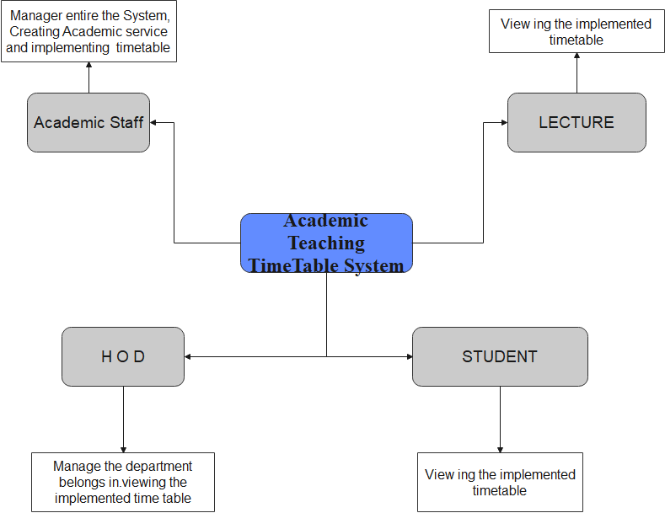
How ATTS works?

Slide 6
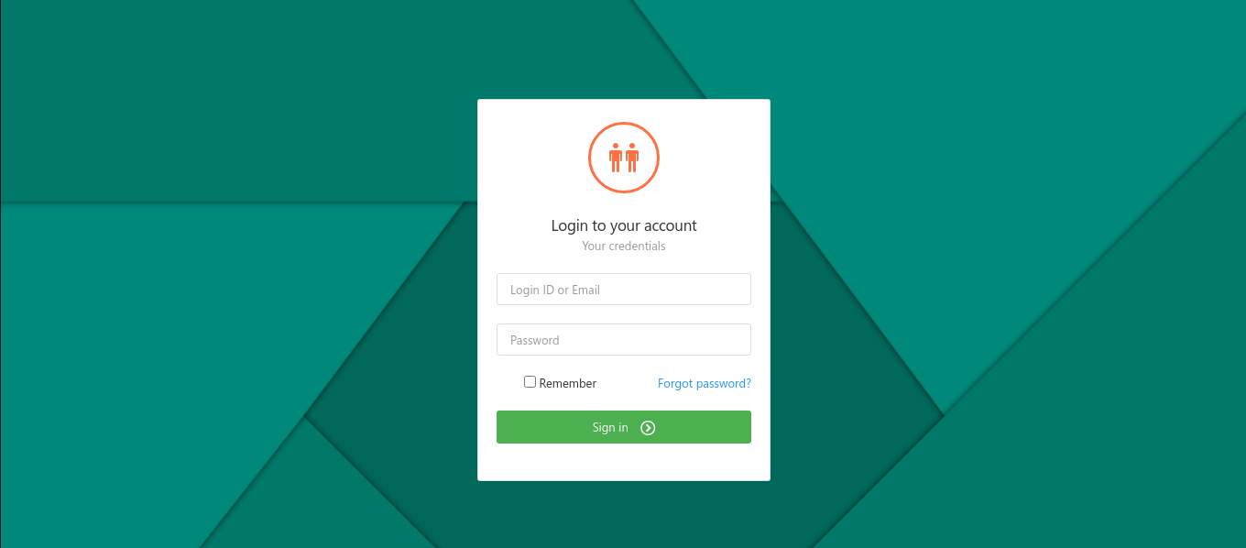
Implementation for ATTS

Slide 7
Conclusion and recommendation
Conclusion
The Academic Teaching Timetable system, is system that generate timetable automatically without setting hours for every course. The users who view that timetable is allowed to view according to the academic year that has been created in time of implementation of it. Some of users view a few pages depends on role they have to the system. Such as academic role view entire system and implement timetable.

Slide 8
Conclusion and recommendation
Recommendation
I would like to recommend other researchers adding some features such as to mark every hour that has been taught on lecture. I would like to recommend other researchers to work on implementation of exams timetable and match them with class daily according to the active academic year.

Slide 9
Q&A

Slide 10
END

